Slide 1





XX Encuentro de Cooperación Farma-Biotech
28 de abril de 2021
Synapse modulators targeting the NCS-1/Ric8a complex for neurodegenerative disorders
María José Sánchez Barrena
Alicia Mansilla

Slide 2
XX Encuentro de Cooperación Farma-Biotech
Content
1. The Research Group
2. The Product
3. Partnering Opportunities
a) Target Indications
b) Innovative mechanisms of action
c) Differential features facing the market
d) Current status of development
e) IPR protection
f) Pitfalls & Risks to be considered

Slide 3

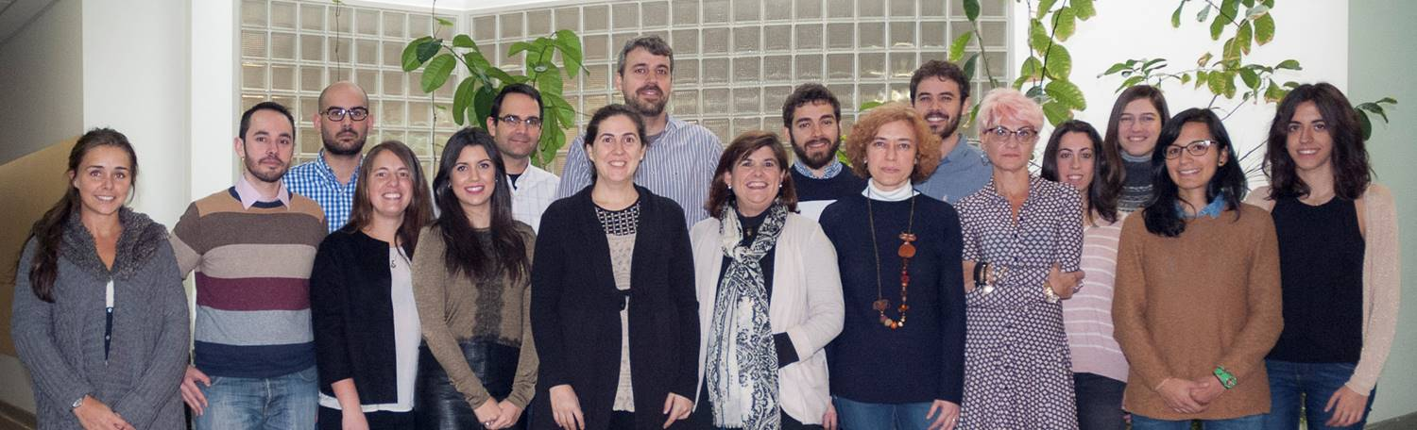
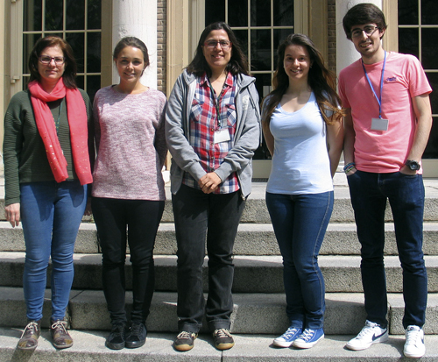







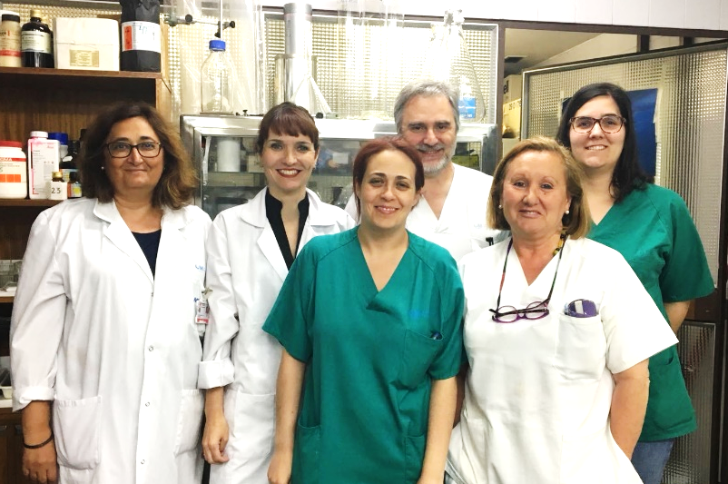
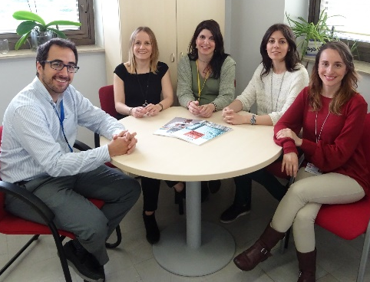

XX Encuentro de Cooperación Farma-Biotech
1. The Research Group
Pérez-Fernández Research Group
Dynamic Combinatorial Chemistry to find new hit compounds
Sanchez-Barrena Research Group
Mechanism of action of the hit compounds:
X-ray Crystallography and Biophysics to understand protein-protein and protein-ligand interactions mediated by NCS-1
CSIC and IRYCIS Transfer Offices
Mansilla Research Group
In vivo validation of the selected hits

Slide 4
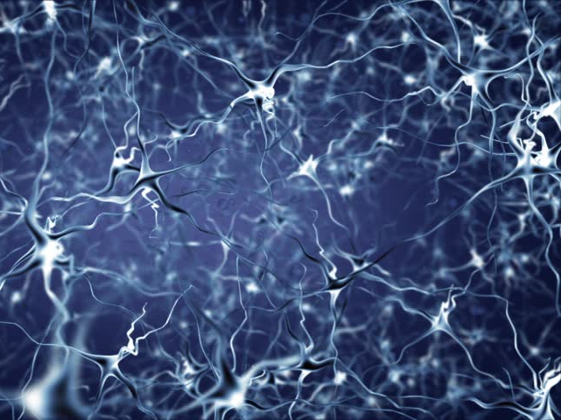
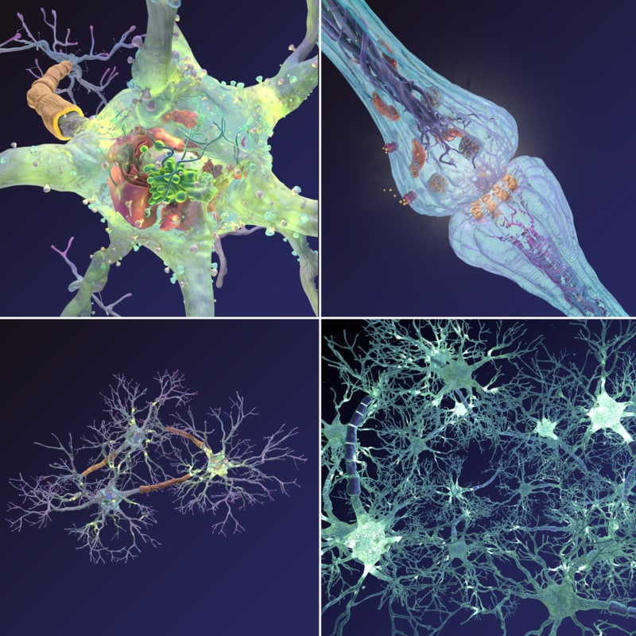


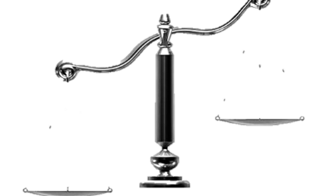
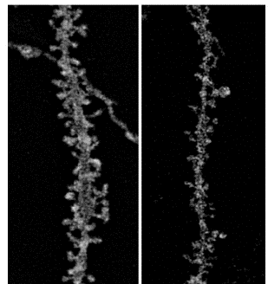
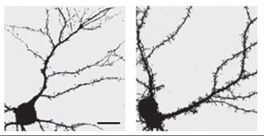
XX Encuentro de Cooperación Farma-Biotech
2. The Product: a) Target Indications
100 billion neurons
1000 trillion synapses
Brain complexity is highly regulated: not only the amount of neurons is important: synapses, the contacts between neurons, are critical for brain function.
Two characteristics are important in synapse function: their number and also the efficiency in neurotransmitter (NT) release (a.k.a. probability of NT release).
Synapse number and probability of NT release are regulated in an antagonistic manner
Control
number
number
probability
probability
probability
number
The product aims to target synaptopathies: pathologies with synapse dysfunction
Degenerative disorders
Synaptopathies by default
(1 out 25 over 60 with dementia)
Developmental disorders
Synaptopathies by excess
(1 out of 60 child with ASD and/or ID)
Control
Alzheimer
Control
Fragile X Syndrome

Slide 5
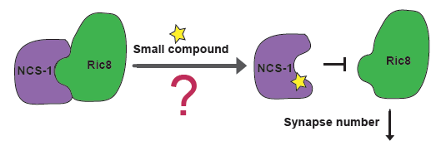
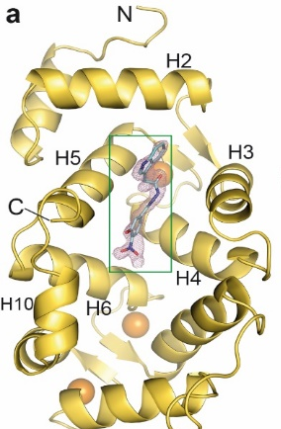

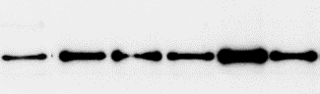

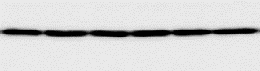


XX Encuentro de Cooperación Farma-Biotech
2. The Product: b) Innovative mechanisms of action
We have found that the formation of the complex between the Neuronal Calcium Sensor 1 NCS-1 and the G-protein activator Ric8a rises up synapse number (Romero-Pozuelo et al, 2014).
We have found molecules that are able to regulate the protein-protein interaction to increase or decrease synapse number which would could be used as therapeutic compounds in synaptopathies (Mansilla et al., 2017; Canal-Martin et al., 2019).
Small compounds
Synapse No.
Synapse No.
Using Dynamic Combinatorial Chemistry approaches, molecules have been found to stabilize the NCS-1/Ric8a complex.
Therapeutic potential in neurodegenerative diseases.
Co-IP based protein-protein interaction assay
X-ray structure of A3H3 bound to NCS-1
DMSO
A3H3
A3H6
DMSO
A8H2
A8H8
A3H17
A3H18
A3H19
IP: anti-NCS1
WB: anti V5
IP: anti-NCS1
WB: anti V5
INPUT
INPUT
The structure explains the molecular mechanism of action
V5-Ric8a
V5-Ric8a
NCS-1
NCS-1
Compound A3H3 is a PPI stabilizer (enhancer)

Slide 6
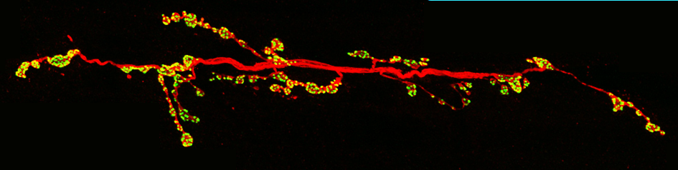
XX Encuentro de Cooperación Farma-Biotech
2. The Product: b) Innovative mechanisms of action
A3H3 (=3b) has been tested in Drosophila melanogaster neuromuscular junction. Number of synapses (yellow dots) are decreased in flies overexpressing the β-amyloid peptide (aβ42arc) and then recovered when treated with the compound.
Synapse recovery by A3H3 (=3b) correlates with a functional improve in the locomotor activity phenotype due to β-amyloid peptide (aβ42arc)
Media of 48h activity ± SEM
% of synapsis
**
Canal A. et al., Nat Comm. 2019

Slide 7
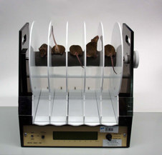
XX Encuentro de Cooperación Farma-Biotech
2. The Product: b) Innovative mechanisms of action
Compound 3b was administered orally to Huntington disease ( HD) mice. An improvement in the motor phenotype in treated mice was revealed by the rotarod test
Pharmacokinetics studies of A3H3 (3b) revealed poor BBB crossing
IP dose: 10mg/Kg
Oral dose: 50mg/Kg
Rotarod
ns
**
Time ( sec.)
Unpublished data

Slide 8
XX Encuentro de Cooperación Farma-Biotech
2. The Product:
c) Differential features facing the market
Our approach is novel and general, as we focus on the functional unit of a neuron, the synapse, which is altered in all these disorders. NCS-1/Ric8a is the first target known to control the probability of neurotransmitters release by each synapse, as well as the synapse number. This makes it the first strategy tackling both neuronal features at the same time.
d) Current status of development
Proof of concept in Drosophila and mice models of neurodegenerative disease showed promising results.
Our high knowledge of the NCS-1 target from the atomic level to the cellular level allows us to develop active molecules with a better capacity to pass the blood-brain barrier

Slide 9
XX Encuentro de Cooperación Farma-Biotech
2. The Product: e) IPR protection
HIT COMPOUND (publication) | PATENTS | SCOPE
A3H3 (Modulator) (Canal et al. Nat. Commun 2019) | Priority: ES2750924 B2 27/09/2018 Application: PCT/ES2019/070649 Owner: CSIC and FIBIO Hospital Ramon y Cajal | Composition A3H3 and other hits. Use of compounds to promote NCS-1 and Ric8a interaction, under a Markush formula.

Slide 10

XX Encuentro de Cooperación Farma-Biotech
2. The Product: f) Pitfalls & Risks to be considered
There is not efficient cross of the blood brain barrier by Compound A3H3 (3b). Derivatives should be tested for BBB crossing.
We haven’t ruled out whether the effect of the compound on synapse number in vivo it is exclusively due to regulation of NCS-1 with Ric8a. Other NCS-1 binding partners are being studied.

Slide 11
XX Encuentro de Cooperación Farma-Biotech
3. Partnering Opportunities
MAIN OBJECTIVE:
We aim to look for a partner that would be interested in the reformulation or optimization of compound A3H3 to improve the penetration through the BBB and with interest in licensing the patents.

